Slide 1
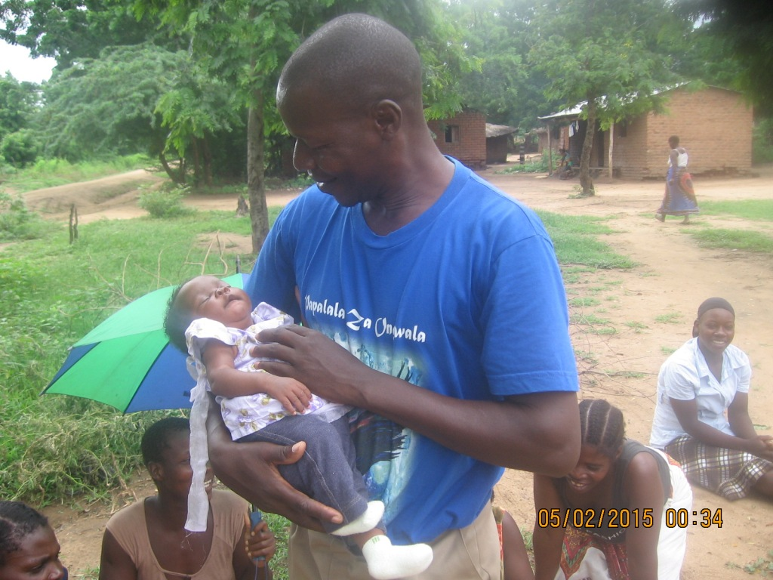
Pastor Julius holding baby born in the floods. The father and other kids died.

